Slide 1

New York City Taxi Fare Prediction
TAXI
COEN 281–Pattern Recognition and Data Mining

Slide 2

Motivation
In the New York city, people use taxi in a frequency much higher than any other cities of US.
The ride-hailing companies like Uber, Lyft and others are giving ability for users to plan their trips ahead which is not possible for city taxi riders.

Slide 3
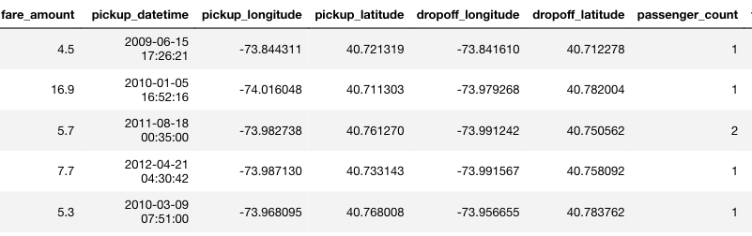
Dataset
Total trips : 55M (Original DS)
Training Data: 2M (Random)
Split: 80% (Train) – 20% (Validation)
Test: 10k
Features: 7

Slide 4
EDA and Data cleaning
Factors which might affect taxi fare:
Trip distance
Time of travel
Day of travel ( Weekend / Weekdays )
From/to airport
Pickup/Drop-off neighborhoods

Slide 5
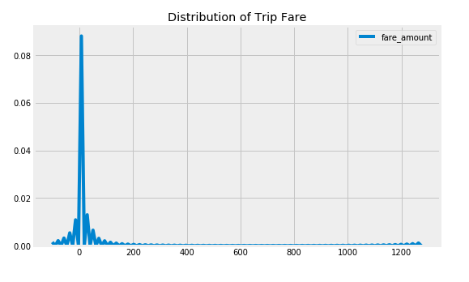
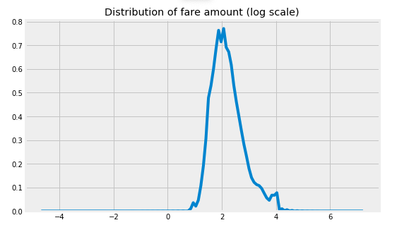
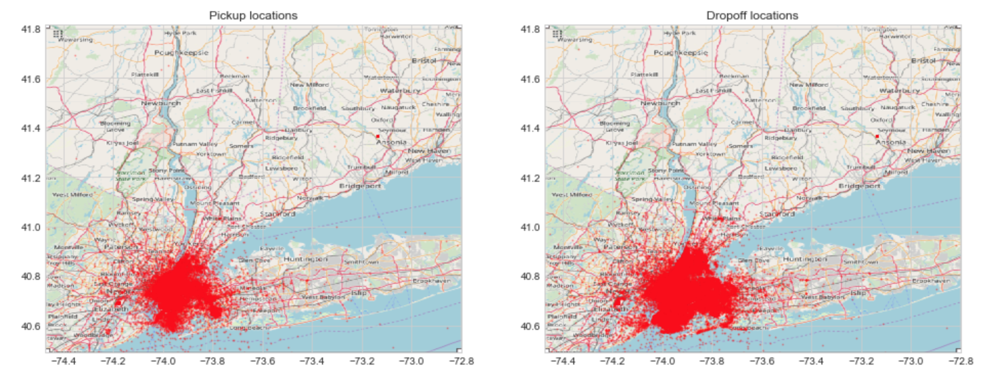
Data Cleaning
Negative fares eliminated
Log transformation of fare amount to remove skewness of curve
Geographical outliers removed by creating boundary box of NYC
Removed trips with zero passenger count and set maximum count as six
Removed data points with zero and null values

Slide 6
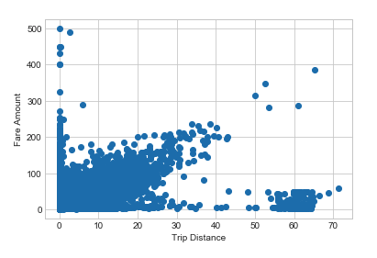
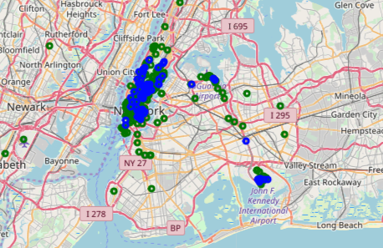
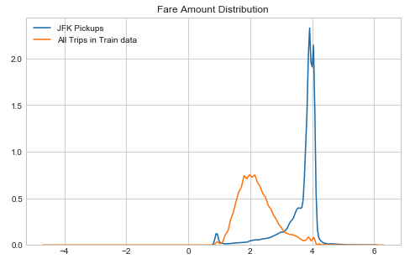
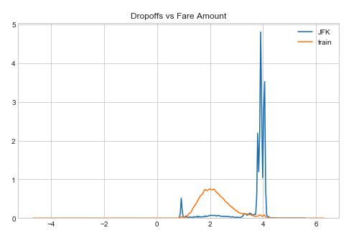
Feature Engg – Trip Distance:
Pick up and drop off for distance > 50
Scatter plot for distance vs fare
Fare is increasing linearly with distance
For distance > 50, fare does not change and observed a cluster of data points in that region
Found out that the cluster coordinates correspond to airports and lower Manhattan
Plotted fare distribution for JFK pick and drop offs vs rest of the data
Added new features representing the same

Slide 7
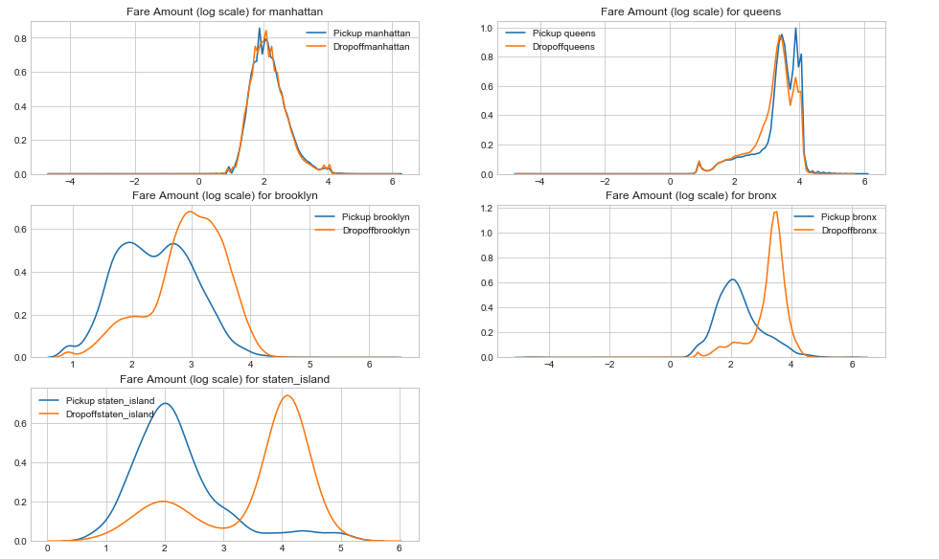
Feature Engg – Neighborhoods :
Divided NYC into 5 boroughs
Plotted fare amount for each borough w.r.t pick up and drop off
Significant difference in pickups and drop offs fare amount for each borough except Manhattan.
Most expensive(pick up) – Queens.
Most expensive (drop off ) – Bronx
Added features like pickup and drop off borough

Slide 8
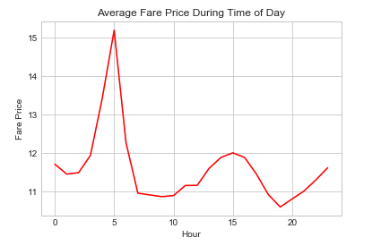
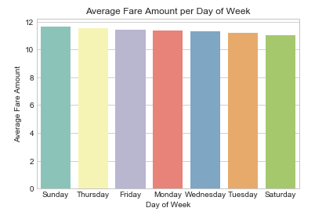
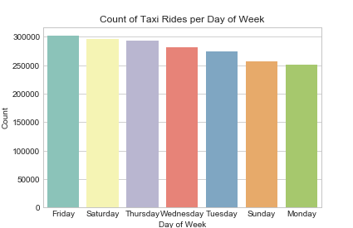
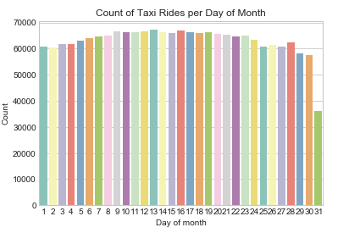
Feature Engg – Time/ day of travel
Divided pickup_datetime in to Hour, day of week, day of month, month and year.
Plotted graph for each of them w.r.t to fare amount
Fare amount at 5am is the highest and at 5 am most of the trips are to the airport
Number of pickups are higher on Saturday, the average fare amount is lower.
On Sunday and Monday number of trips are lower, avg fare amount is higher
Demand is highest at 7PM and lowest at 5am

Slide 9
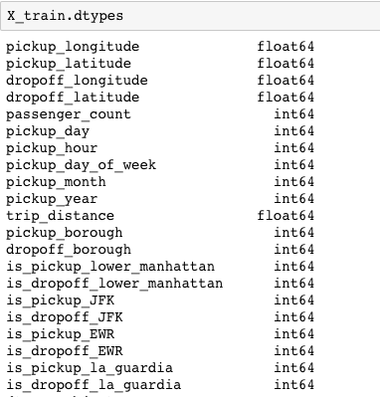
After Feature Engg :
# of Features : 21

Slide 10
Models and Prediction
Model | RMSE without feature engg | RMSE with feature engg
Linear Regression(base) | 8.33 | 5.17
Random Forest | 3.89 | 3.80
Light GBM | 4.00 | 3.74
Neural network (seq) | 9.692 | 4.818
Neural network (mlp) | 9.698 | 4.817

Slide 11
Conclusion:
Trip distance was found to be the most important and Passenger count to be least important feature in determining the fare amount
Significant drop in RMSE after feature engineering
Fare amount and demand were found to be inversely proportional
Final model is a trade off between loss, time taken and variance while taking into account the model complexity

Slide 12
THANK YOU

